Slide 1
STOR 455 Class 21
Read: 4.3
Exercises: 4.8, 9

Slide 2
Example: State SAT Scores
Source: Statistical Sleuth, Case 12.1 pg. 339
Response Variable:
SAT =Average combined SAT Score
Potential Predictors:
Takers = % taking the exam
Income = median family income ($100’s)
Years = avg. years of study (SS, NS, HU)
Public = % public school
Expend = spend per student ($100’s)
Rank = median class rank of takers

Slide 3
Second Order Models
Definition: A second order model for two quantitative predictors would be
first order
quadratic
interaction
second order
Example: Try a full second order model for
Y=SAT using X₁=Takers and X₂=Expend

Slide 4
Second Order Model for State SAT
modSAT2ndorder = lm(SAT~Takers+Expend+I(Takers^2)+I(Expend^2)+I(Takers*Expend),data=StateSAT)
summary(modSAT2ndorder)
Coefficients:
Estimate Std. Error t value Pr(>|t|)
(Intercept) 893.66283 36.14094 24.727 < 2e-16 ***
Takers -7.05561 0.83740 -8.426 9.96e-11 ***
Expend 10.33333 2.49600 4.140 0.000155 ***
I(Takers^2) 0.07725 0.01328 5.816 6.28e-07 ***
I(Expend^2) -0.11775 0.04426 -2.660 0.010851 *
I(Takers * Expend) -0.03344 0.03716 -0.900 0.373087
---
Residual standard error: 23.68 on 44 degrees of freedom
Multiple R-squared: 0.8997, Adjusted R-squared: 0.8883
F-statistic: 78.96 on 5 and 44 DF, p-value: < 2.2e-16
Do we need the interaction term?
Do we need the second order terms?
Do we need the terms with Expend?

Slide 5
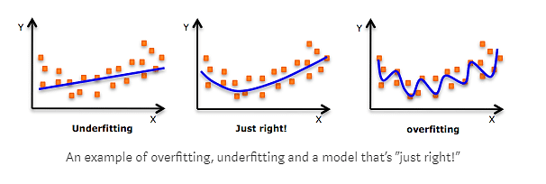
Cross Validation
Concern: A model may reflect the structure of a particular sample, but not generalize well to the population.

Slide 6
Cross Validation
Concern: A model may reflect the structure of a particular sample, but not generalize well to the population.
To see if this is a problem:
Split the original sample into two parts
(a) A “training” sample to build a model
(b) A “holdout” sample to test the model

Slide 7
Example: Pulse Rates
Response Variable:
Active pulse
Predictors:
Resting pulse
Hgt
Wgt
Sex (0=M, 1=F)
Smoke (0=No, 1=Yes)
Exercise (1=Slight, 2=Moderate, 3=Lots)

Slide 8
Example: Active Pulse Rates
Training sample – first 300 cases (PulseTrain)
Holdout sample – #301-375 (PulseHoldout)
set.seed(12345)
rows <- sample(nrow(Pulse))
Pulse_shuffled = Pulse [rows,]
PulseTrain= Pulse_shuffled [1:300,]
PulseHoldout= Pulse_shuffled [301:375,]
What is the best model to predict Active pulse?

Slide 9
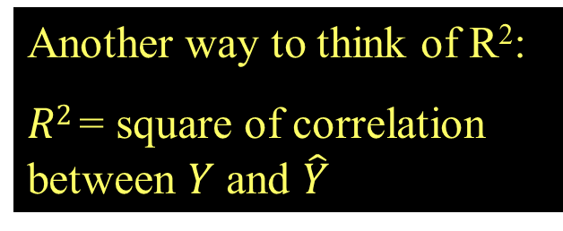
Fit for Training Model
PulseTrainMod=lm(Active~Rest+Sex+Hgt+Wgt,data=PulseTrain)
Another way to think of R²:
$R2$= square of correlation between $Y$ and $\hat{Y}$
Call:
lm(formula = Active ~ Rest + Sex + Hgt + Wgt, data = PulseTrain)
Residuals:
Min 1Q Median 3Q Max
-34.869 -8.916 -2.794 6.515 68.782
Coefficients:
Estimate Std. Error t value Pr(>|t|)
(Intercept) 33.70967 23.49083 1.435 0.15234
Rest 1.19626 0.08650 13.830 < 2e-16 ***
Sex 4.30152 2.51881 1.708 0.08873 .
Hgt -0.69392 0.35542 -1.952 0.05184 .
Wgt 0.11892 0.04128 2.881 0.00426 **
---
Signif. codes: 0 ‘***’ 0.001 ‘**’ 0.01 ‘*’ 0.05 ‘.’ 0.1 ‘ ’ 1
Residual standard error: 14.44 on 295 degrees of freedom
Multiple R-squared: 0.4216, Adjusted R-squared: 0.4137
F-statistic: 53.75 on 4 and 295 DF, p-value: < 2.2e-16

Slide 10
How does the training model work for the holdout sample?
Compute predicted values for the holdout sample using the fitted prediction equation from the training.
fitActive=predict(mod,newdata=PulseHoldout)
Compute the residuals for the holdout sample.
holdoutresid=PulseHoldout$Active - fitActive

Slide 11
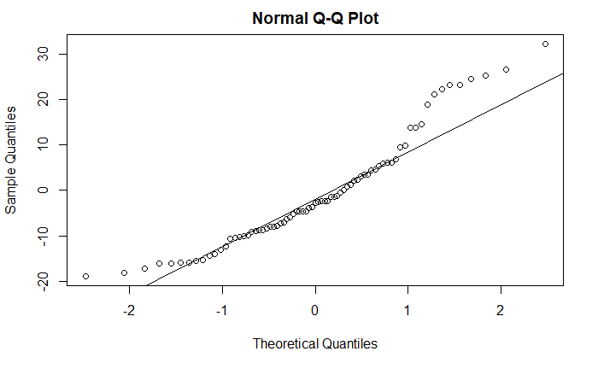

Check the Holdout Residuals
Compute mean and std. deviation of residuals.
Is the mean near zero? Is std. dev. near ${\hat{σ}}_{ε}$?
mean(holdoutresid)
[1] -0.826801
sd(holdoutresid)
[1] 12.21473
A bit biased (predictions too low), slightly less variability in errors.
Are the differences from expected close to 0 in terms of the scale of the data?
Is this skew also present in the residual diagnostics of the training data?

Slide 12
Cross Validation Correlation and Shrinkage
Compute the correlation between predicted and actual response values for the holdout sample. This is known as the cross validation correlation.
cor(PulseHoldout$Active,fitActive)
[1] 0.6474953

Slide 13
Shrinkage
Square the correlation to get a cross validation R² and compare it to R² for the training sample
Since the model was optimized for the training sample, we expect less R² for the holdout.
The difference (Training R² – Holdout R²) is known as shrinkage.
crosscorr=cor(PulseHoldout$Active,fitActive)
crosscorr
[1] 0.6474953
crosscorr^2
[1] 0.4192502
0.4544-crosscorr^2
[1] 0.002325805
The shrinkage (0.0023) is great. The training model seemed to perform as well on the holdout sample as it did on the data it was optimized for.

Slide 14
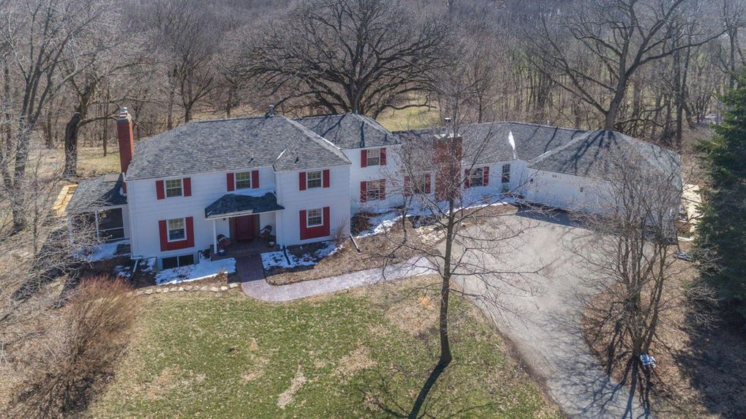
Ames Iowa Housing Prices
How would your model fit a new set of data?

Slide 15
How does your Ames Housing training model work for a new sample?
Compute predicted values for the holdout sample using the fitted prediction equation from the training.
Compute the residuals for the holdout sample.
Compute mean and std. deviation of residuals.
Compute the correlation between predicted and actual response values for the holdout sample.
Compute the shrinkage

